Slide 1

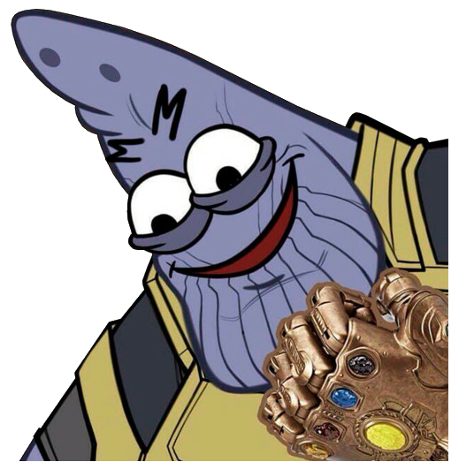

Slide 2
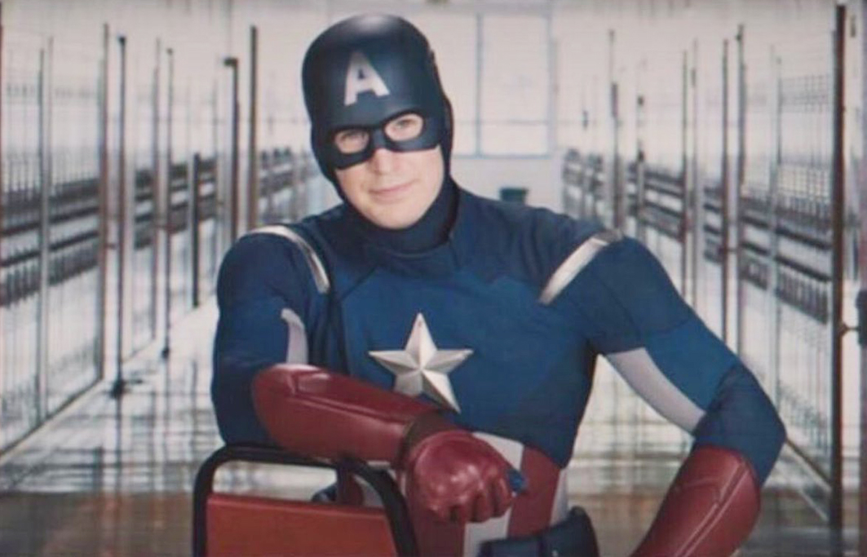
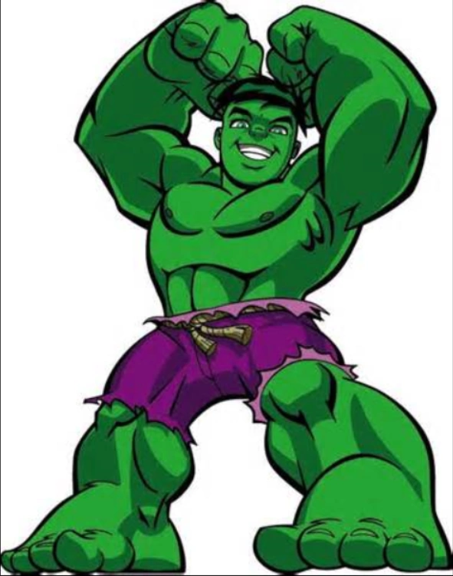
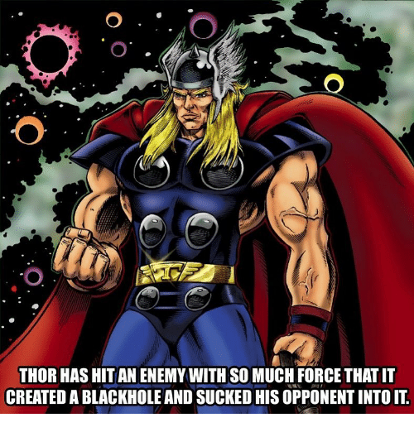
Anggota Kelompok
Trio Kurniawan
171111042
Mahsa Savira
171111078
Panji Iman Baskoro
171111023
Sherly Brelinda H
171111048

Slide 3
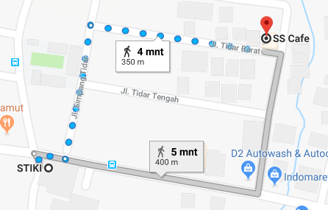
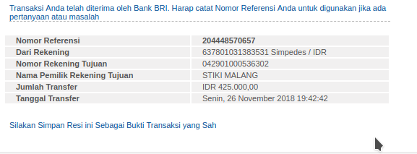

SS Cafe Tidar

Slide 4
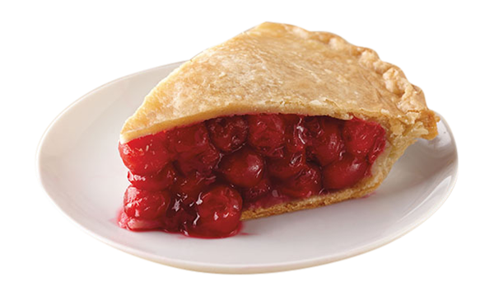
PEI

Slide 5
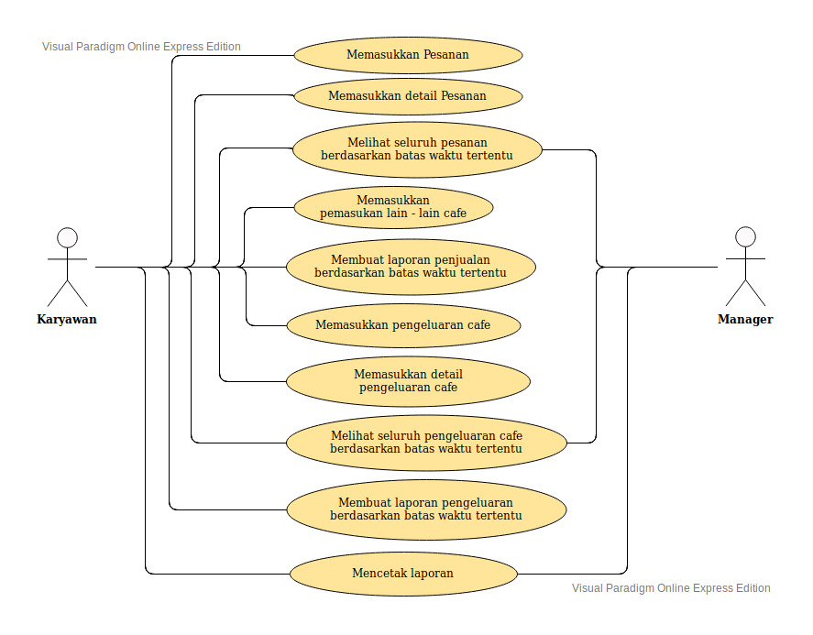
Use Case Diagram

Slide 6
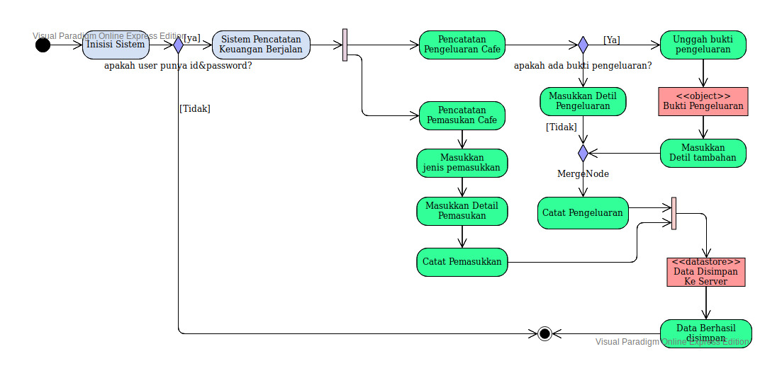
Activity Diagram : after

Slide 7
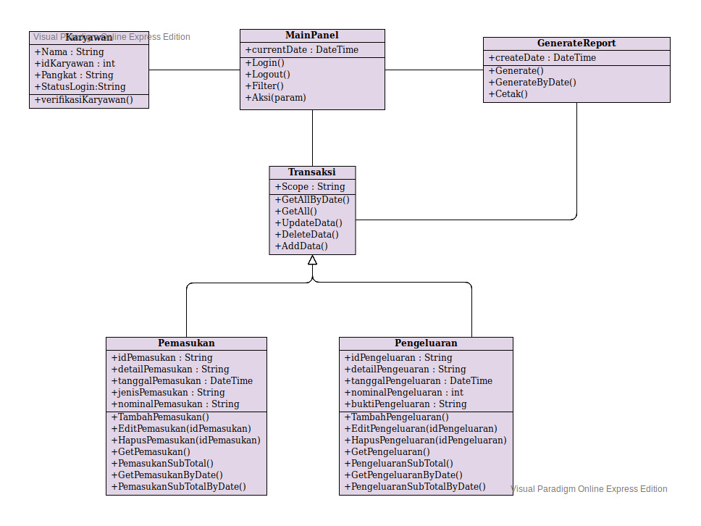
Class Diagram

Slide 8
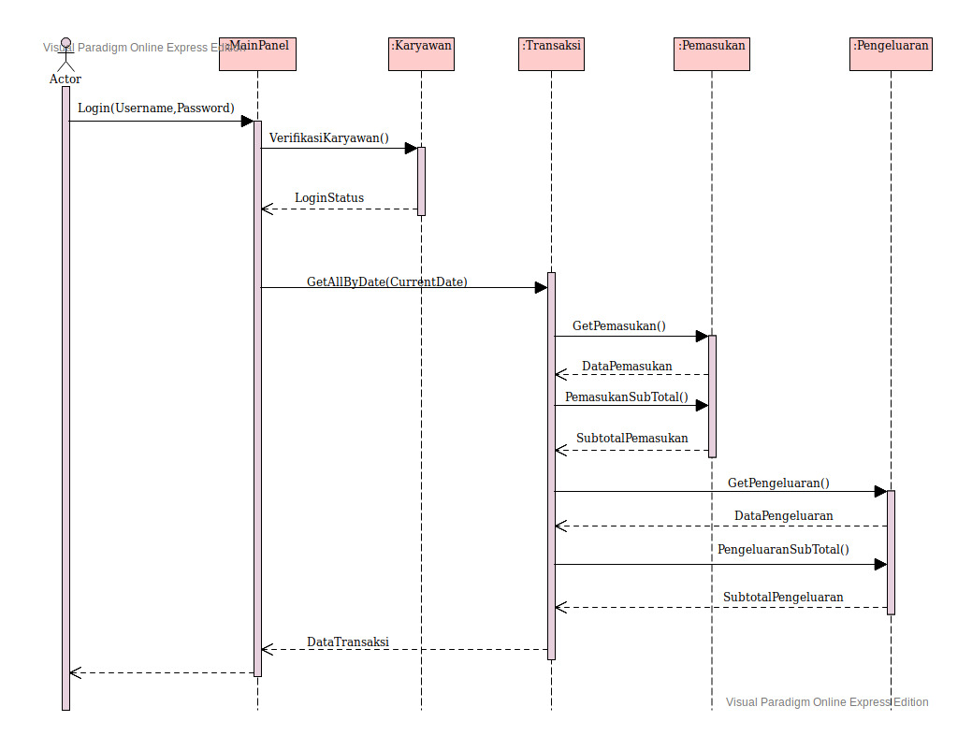
Sequence Diagram : Login

Slide 9
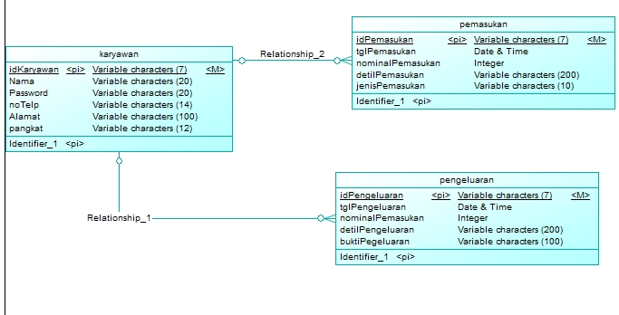
Entity Relationship Diagram
CDM

Slide 10
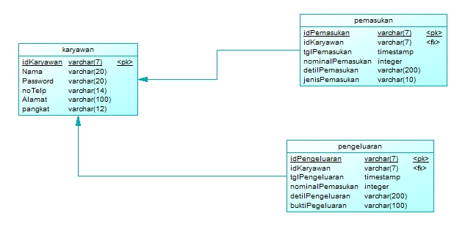
Entity Relationship Diagram
PDM

Slide 11
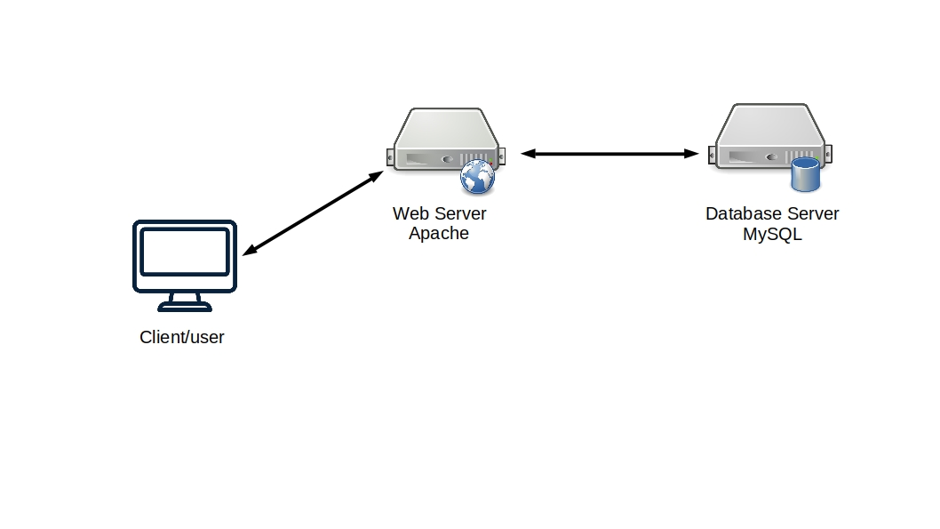
Network Diagram
localhost

Slide 12
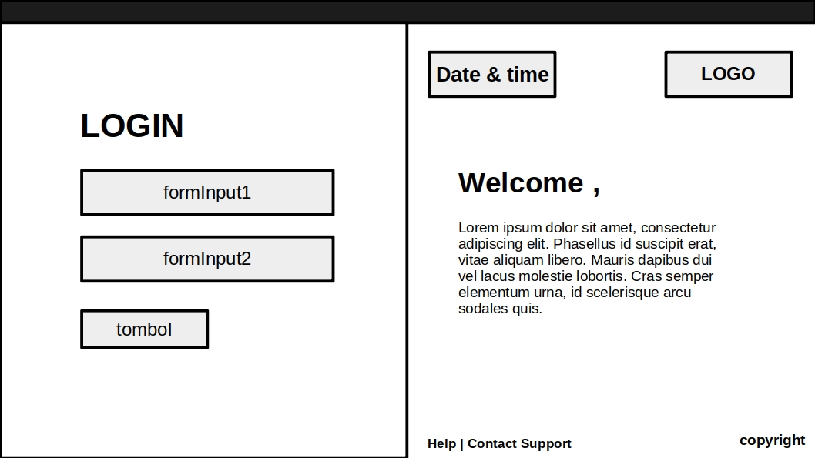
Mockup

Slide 13
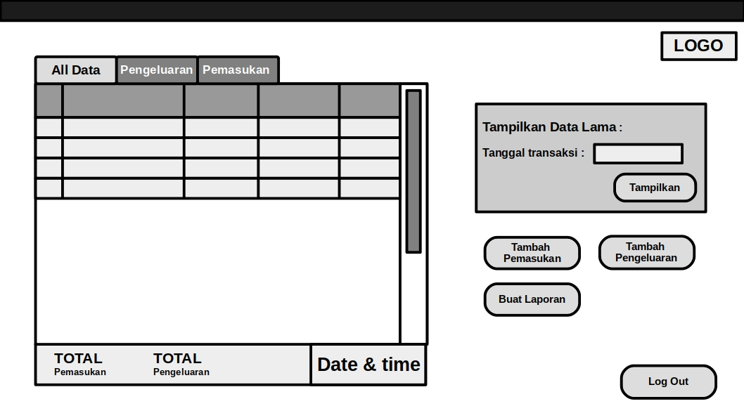
Mockup

Slide 14
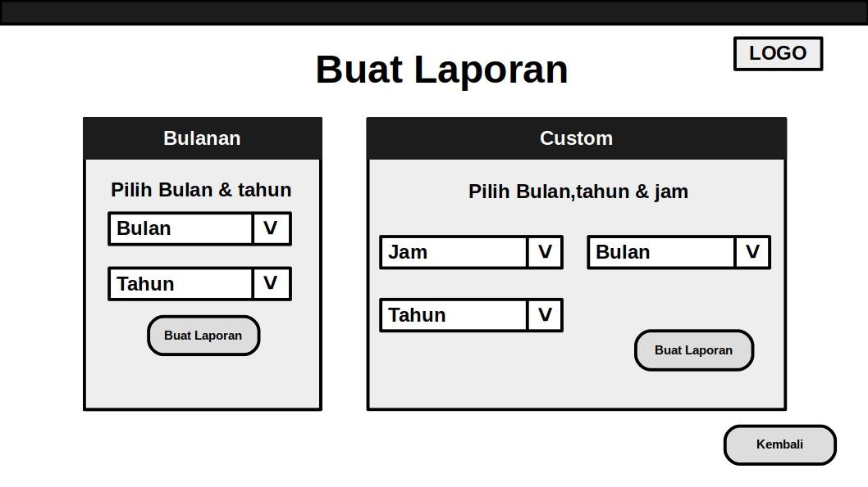
Mockup

Slide 15
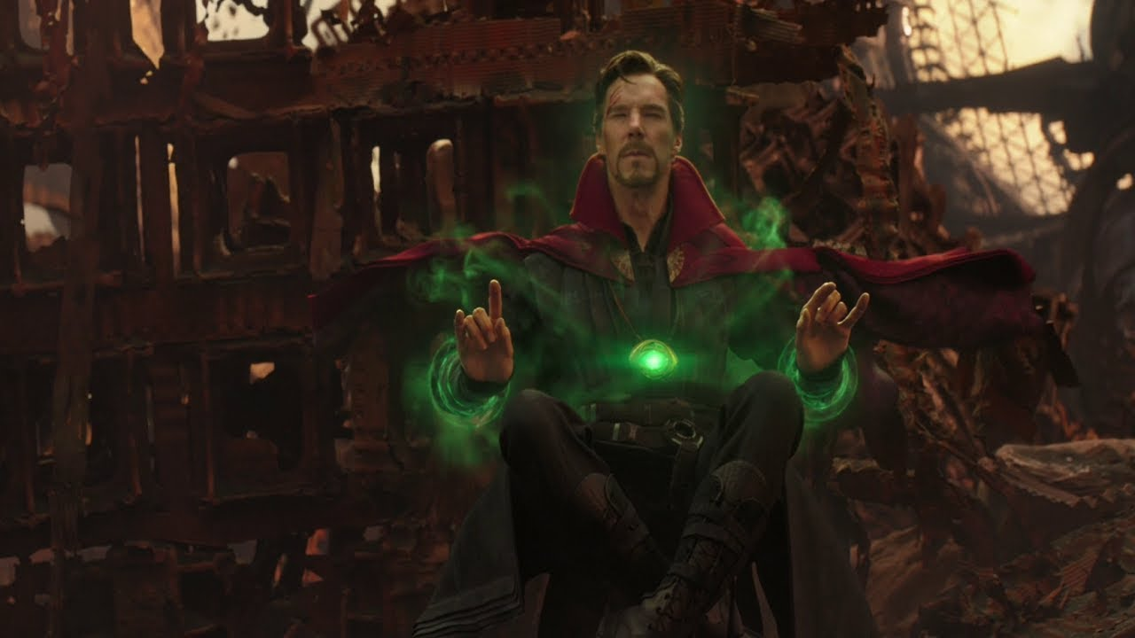
Dr. Strange see 14.000.650 possible futures and the avengers only has 1 chance to win against Thanos

Slide 16

e n d g a m e

